Slide 1

Econ251
Demo on use of WITS data site
https://wits.worldbank.org/

Slide 2
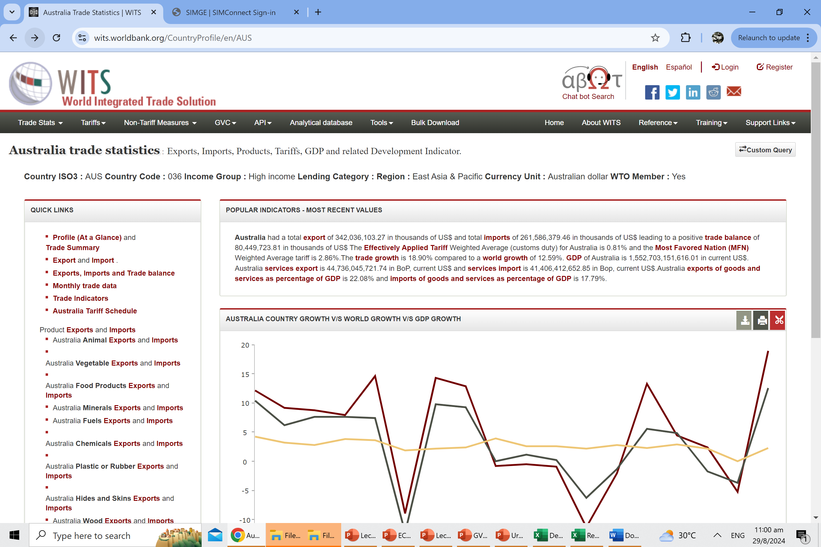
1

Slide 3
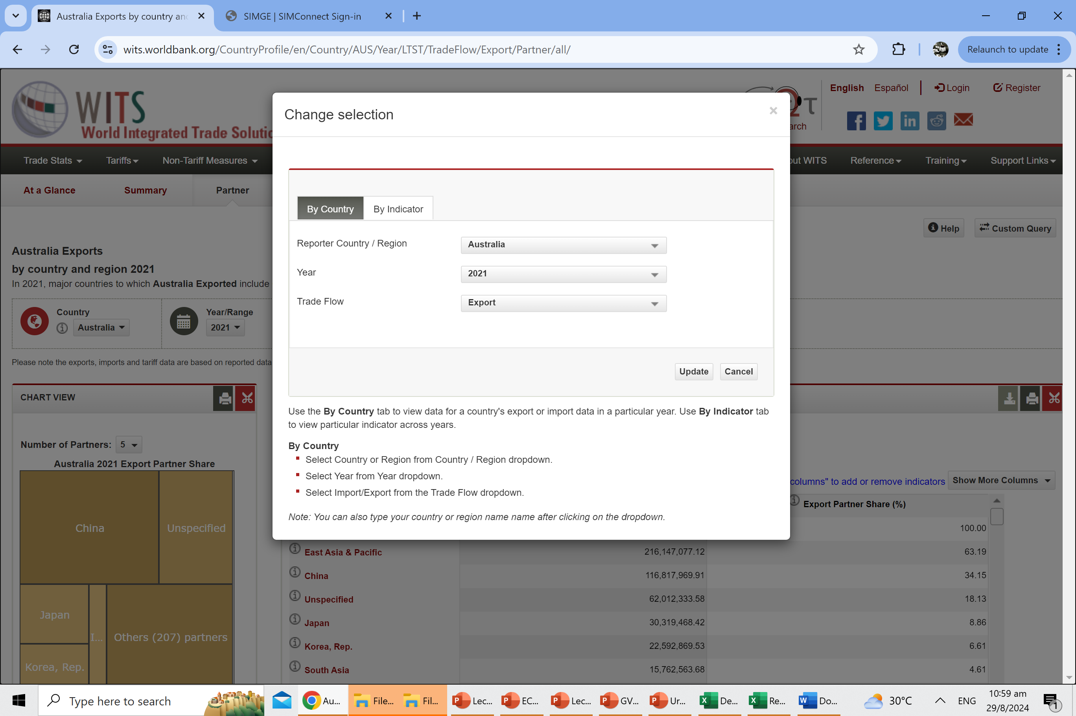
3
2

Slide 4
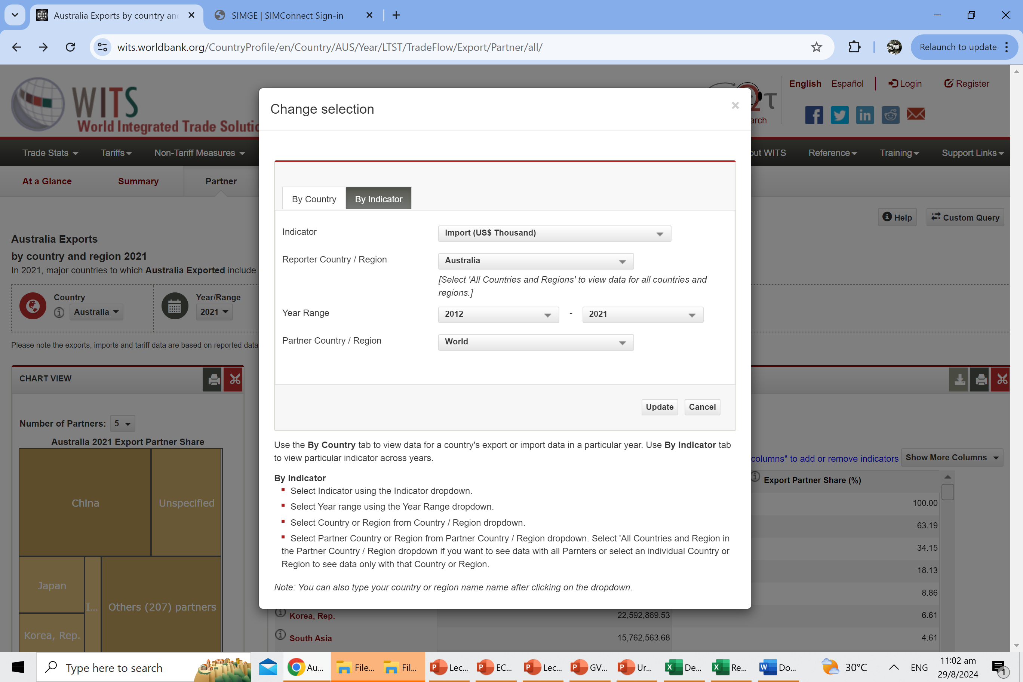
4
5
6
7
8

Slide 5
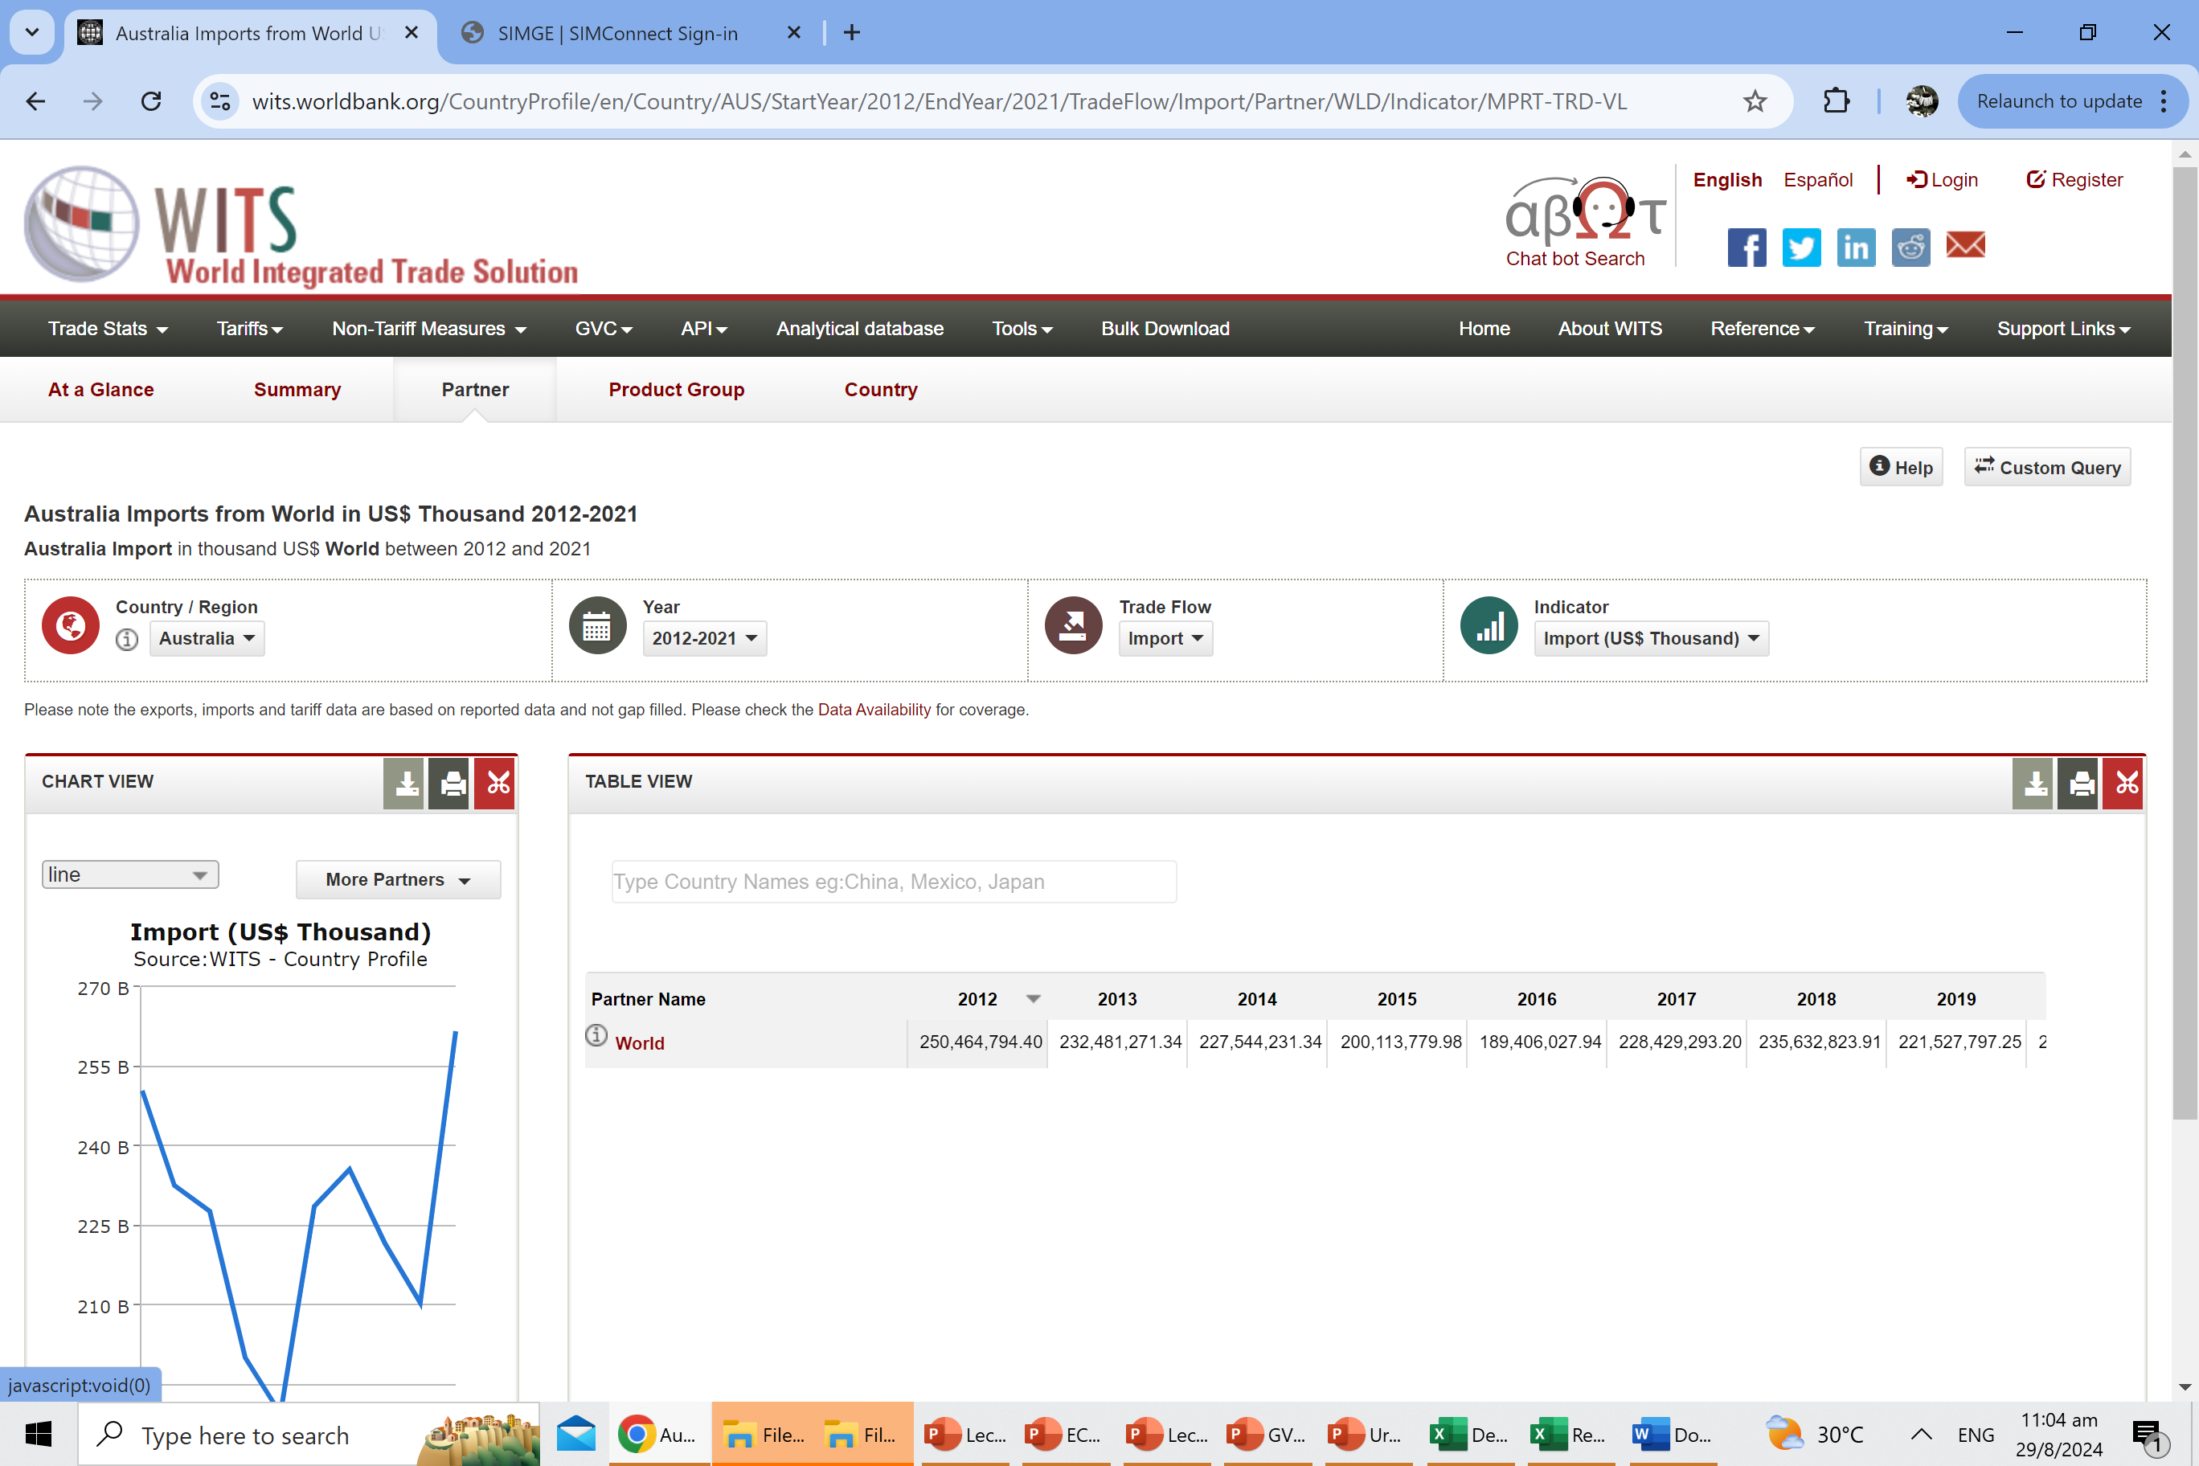
You can then use this page to change the selection to export
7
A reminder that you CANNOT screen shot the line chart on the left. Please download the data and use excel to plot the line or bar chart and insert the trend line
Guide to insert trend line
https://support.microsoft.com/en-us/office/add-a-trend-or-moving-average-line-to-a-chart-fa59f86c-5852-4b68-a6d4-901a745842ad

